Slide 1

Computer Operating Systems BLG 312E
3rd Piece: Persistence
Prof. Dr. Kemal Bıçakcı

Slide 2
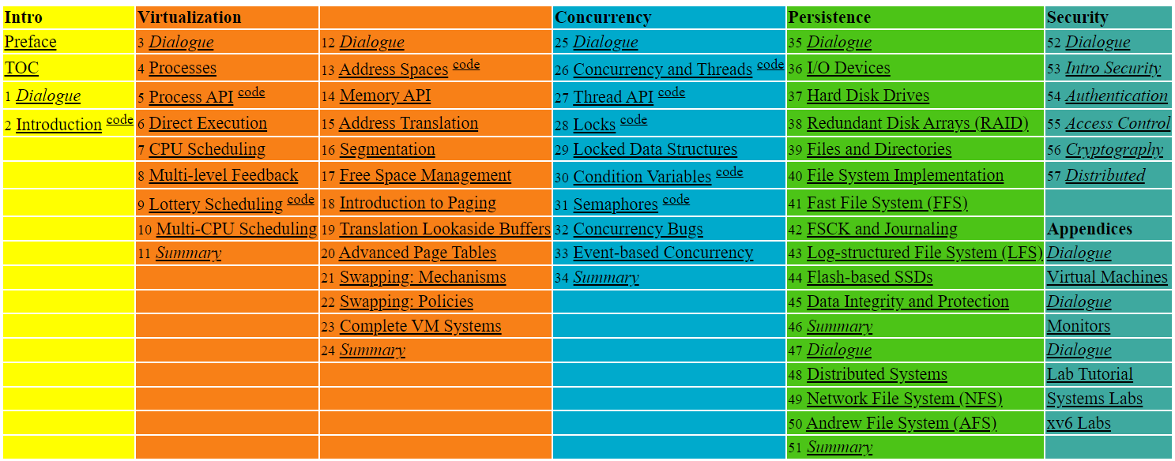

Slide 3
36. I/O Devices
Operating System: Three Easy Pieces

Slide 4
I/O Devices
I/O is critical to computer systems.
Clearly, for computer systems to be interesting, both input and output are required.
Issues:
How should I/O be integrated into systems?
What are the general mechanisms?
How can we make them efficiently?

Slide 5
System Architecture
CPU
Memory
Memory Bus
(proprietary)
General I/O Bus
(e.g., PCI)
Graphics
Peripheral I/O Bus
(e.g., SCSI, SATA, USB)
Prototypical System Architecture
CPU is attached to the main memory of the system via some kind of memory bus. Some devices are connected to the system via a general I/O bus.
Even lower down are one or more of what we call a peripheral bus.

Slide 6
I/O Architecture
Buses
Data paths that provides to enable information between CPU(s), RAM, and I/O devices.
I/O bus
Data path that connects a CPU to an I/O device.
I/O bus is connected to I/O device by three hardware components: I/O ports, interfaces and device controllers.

Slide 7
Canonical Device
Canonical Devices have two important components:
Hardware interface allows the system software to control its operation.
Internals which is implementation specific.
Registers:
Status
Command
Data
interface
Micro-controller(CPU)
Memory (DRAM or SRAM or both)
Other Hardware-specific Chips
internals
Canonical Device

Slide 8
Hardware Interface of a Canonical Device
status register
To see the current status of the device
command register
To tell the device to perform a certain task
data register
To pass data to the device, or get data from the device
By reading and writing above three registers,
the operating system can control device behavior.

Slide 9
Hardware Interface of a Canonical Device (Cont.)
Typical interaction example:
while ( STATUS == BUSY)
; //wait until device is not busy
write data to data register
write command to command register
Doing so starts the device and executes the command
while ( STATUS == BUSY)
; //wait until device is done with your request

Slide 10
Polling
Operating system waits until the device is ready by repeatedly reading the status register.
Positive aspect: simple and working.
However, it wastes CPU time just waiting for the device.
Switching to another ready process is better.
“waiting IO”
1
P
: task 1
: polling
CPU
.1 | 1 | 1 | 1 | 1 | p | p | p | p | p | 1 | 1 | 1 | 1 | 1
Disk
1 | 1 | 1 | 1 | 1
Diagram of CPU utilization by polling

Slide 11
Interrupts
Put the I/O request process to sleep and context switch to another.
When the device is finished, wake the process waiting for the I/O by interrupt.
Positive aspect: allow CPU and the disk properly utilized.
1
2
: task 1
: task 2
CPU
1 | 1 | 1 | 1 | 1 | 2 | 2 | 2 | 2 | 2 | 1 | 1 | 1 | 1 | 1
Disk
1 | 1 | 1 | 1 | 1
Diagram of CPU utilization by interrupt

Slide 12
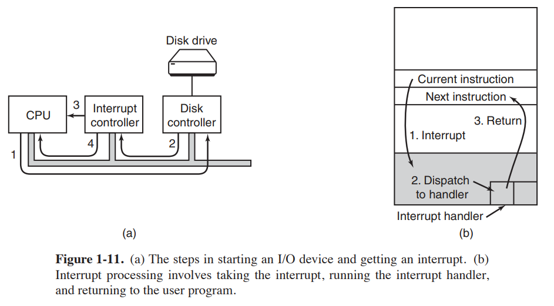
I/O by Interrupts
Tanenbaum, Modern Operating Systems 3 e, (c) 2008 Prentice-Hall, Inc. All rights reserved. 0-13-6006639

Slide 13
Polling vs. Interrupt
However, “interrupt is not always the best solution”
If, device performs very quickly, interrupt will “slow down” the system.
Because context switch is expensive (switching to another process)
If a device is fast → polling is better.
If it is slow → interrupt is better.

Slide 14
CPU is once again over-burdened
CPU wastes a lot of time to copy the a large chunk of data from memory to the device.
1
2
“over-burdened”
: task 1
: task 2
C
: copy data from memory
CPU
1 | 1 | 1 | 1 | C | C | C | 2 | 2 | 2 | 2 | 2 | 1 | 1 | 1
Disk
1 | 1 | 1 | 1 | 1
Diagram of CPU utilization

Slide 15
DMA (Direct Memory Access)
Copy data in memory without much CPU intervention by knowing “where the data lives in memory, how much data to copy”.
When completed, DMA raises an interrupt, I/O begins on Disk.
1
2
: task 1
: task 2
C
: copy data from memory
CPU
1 | 1 | 1 | 1 | 2 | 2 | 2 | 2 | 2 | 2 | 2 | 2 | 1 | 1 | 1
DMA
C | C | C
Disk
1 | 1 | 1 | 1 | 1
Diagram of CPU utilization by DMA

Slide 16
Device Interaction
How the OS communicates with the device?
Solutions
I/O instructions: a way for the OS to send data to specific device registers.
E.g., in and out instructions on x86
memory-mapped I/O
Device registers available as if they were memory locations.
The OS load (to read) or store (to write) to the device instead of main memory.

Slide 17
Device Interaction (Cont.)
How the OS interact with different specific interfaces?
E.g., We’d like to build a file system that works on top of SCSI disks, IDE disks, USB keychain drivers, and so on.
Solutions: Abstraction
Abstraction encapsulates any specifics of device interaction.

Slide 18
File System Abstraction
File system is completely oblivious to the specifics of which disk class it is using.
It issues block read and write request to the generic block layer.
Application
user
POSIX API [open, read, write, close, etc]
File System
kernel
Generic Block Interface [block read/write]
Generic Block Layer
Specific Block Interface [protocol-specific read/write]
Device Driver [SCSI, ATA, etc]
The File System Stack

Slide 19
Problem of Abstraction
If there is a device having special capabilities, these capabilities will go unused in the generic interface layer.

Slide 20
Device Drivers
Over 70% of OS code is found in device drivers.
Any device drivers are needed because you might plug it to your system.
They are primary contributor to kernel crashes, making more bugs.

Slide 21
A Simple IDE Disk Driver
Four types of register
Control, command block, status and error
in and out I/O instructions

Slide 22
A Simple IDE Disk Driver (Cont’d)
Control Register:
Address 0x3F6 = 0x80 (0000 1RE0): R=reset, E=0 means "enable interrupt”
Command Block Registers:
Address 0x1F0 = Data Port
Address 0x1F1 = Error
Address 0x1F2 = Sector Count
Address 0x1F3 = LBA low byte
Address 0x1F4 = LBA mid byte
Address 0x1F5 = LBA hi byte
Address 0x1F6 = 1B1D TOP4LBA: B=LBA, D=drive
Address 0x1F7 = Command/status

Slide 23
A Simple IDE Disk Driver (Cont’d)
Status Register (Address 0x1F7):
7 6 5 4 3 2 1 0
BUSY READY FAULT SEEK DRQ CORR IDDEX ERROR
Error Register (Address 0x1F1): (check when Status ERROR==1):
7 6 5 4 3 2 1 0
BBK UNC MC IDNF MCR ABRT T0NF AMNF
BBK = Bad Block
UNC = Uncorrectable data error
MC = Media Changed
IDNF = ID mark Not Found
MCR = Media Change Requested
ABRT = Command aborted
T0NF = Track 0 Not Found
AMNF = Address Mark Not Found

Slide 24
A Simple IDE Disk Driver (Cont’d)
Wait for drive to be ready. Read Status Register (0x1F7) until drive is not busy and READY.
Write parameters to command registers. Write the sector count, logical block address (LBA) of the sectors to be accessed, and drive number (master=0x00 or slave=0x10, as IDE permits just two drives) to command registers (0x1F2-0x1F6).
Start the I/O. by issuing read/write to command register. Write READ—WRITE command to command register (0x1F7).
Data transfer (for writes): Wait until drive status is READY and DRQ (drive request for data); write data to data port.
Handle interrupts. In the simplest case, handle an interrupt for each sector transferred; more complex approaches allow batching and thus one final interrupt when the entire transfer is complete.
Error handling. After each operation, read the status register. If the ERROR bit is on, read the error register for details.

Slide 25
A Simple IDE Disk Driver (xv6 – Main Functions)
void ide_rw(struct buf *b) {}
static void ide_start_request(struct buf *b) {}
static int ide_wait_ready() {}
void ide_intr() {}

Slide 26
A Simple IDE Disk Driver (Cont’d)
void ide_rw(struct buf *b) {
acquire(&ide_lock);
for (struct buf **pp = &ide_queue; *pp; pp=&(*pp)>qnext)
; // walk queue
*pp = b; // add request to end
if (ide_queue == b) // if q is empty
ide_start_request(b); // send req to disk
while ((b->flags & (B_VALID|B_DIRTY)) != B_VALID)
sleep(b, &ide_lock); // wait for completion
release(&ide_lock);
}

Slide 27
A Simple IDE Disk Driver (xv6)
static void ide_start_request(struct buf *b) {
ide_wait_ready();
outb(0x3f6, 0); // generate interrupt
outb(0x1f2, 1); // how many sectors?
outb(0x1f3, b->sector & 0xff); // LBA goes here ...
outb(0x1f4, (b->sector >> 8) & 0xff); // ... and here
outb(0x1f5, (b->sector >> 16) & 0xff); // ... and here!
outb(0x1f6, 0xe0 | ((b->dev&1)<<4) | ((b->sector>>24)&0x0f));
if(b->flags & B_DIRTY){
outb(0x1f7, IDE_CMD_WRITE); // this is a WRITE
outsl(0x1f0, b->data, 512/4); // transfer data too!
} else {
outb(0x1f7, IDE_CMD_READ); // this is a READ (no data)
}
}

Slide 28
A Simple IDE Disk Driver (xv6)
static int ide_wait_ready() {
while (((int r = inb(0x1f7)) & IDE_BSY) ||
!(r & IDE_DRDY))
; // loop until drive isn’t busy
}

Slide 29
A Simple IDE Disk Driver (Cont’d)
void ide_intr() {
struct buf *b;
acquire(&ide_lock);
if (!(b->flags & B_DIRTY) && ide_wait_ready(1) >= 0)
insl(0x1f0, b->data, 512/4); // if READ: get data
b->flags |= B_VALID;
b->flags &= ˜B_DIRTY;
wakeup(b); // wake waiting process
if ((ide_queue = b->qnext) != 0) // start next request
ide_start_request(ide_queue); // (if one exists)
release(&ide_lock);
}

Slide 30
Explanation
ide_rw queues a request (if there are others pending), or issues it directly to the disk (via ide_start_request).
In either case, the routine waits for the request to complete and the calling process is put to sleep.
ide_start_request is used to send a request (and perhaps data, in the case of a write) to the disk; the in and out x86 instructions are called to read and write device registers, respectively.
The start request routine uses the third function, ide_wait_ready, to ensure the drive is ready before issuing a request to it.
Finally, ide_intr() is invoked when an interrupt takes place; it reads data from the device (if the request is a read, not a write), wakes the process waiting for the I/O to complete, and (if there are more requests in the I/O queue), launches the next I/O via ide_start_request.

Slide 31
37. Hard Disk Drives
Operating System: Three Easy Pieces

Slide 32
Hard Disk Driver
Hard disk drivers have been the main form of persistent data storage in computer systems for decades.
HDD vs. SSD?
The drive consists of a large number of sectors (512-byte blocks).
Address Space :
We can view the disk with n sectors as an array of sectors; 0 to n-1.

Slide 33
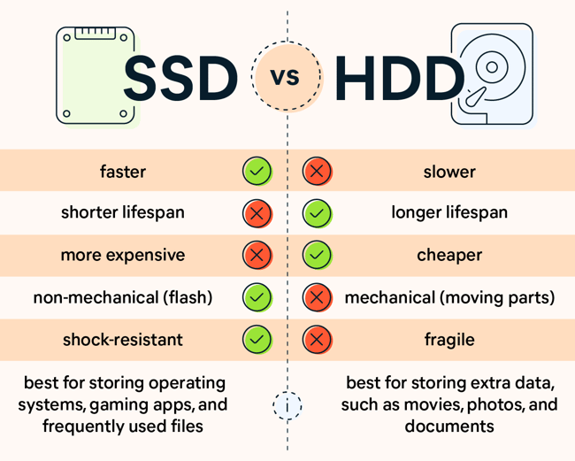

Slide 34
Interface
The only guarantee is that a single 512-byte write is atomic.
Multi-sector operations are possible.
Many file systems read or write 4KB at a time.
Torn write:
If an untimely power loss occurs, only a portion of a larger write may complete.
Accessing blocks in a contiguous chunk is the fastest access mode.
A sequential read or write
Much faster than any more random access pattern.

Slide 35
Basic Geometry
spindle
Platter (Aluminum coated with a thin magnetic layer)
A circular hard surface
Data is stored persistently by inducing magnetic changes to it.
Each platter has 2 sides, each of which is called a surface.
A Disk with Just A Single Track (12 sectors)

Slide 36
Basic Geometry (Cont.)
Spindle
Spindle is connected to a motor that spins the platters around.
The rate of rotations is measured in RPM (Rotations Per Minute).
Typical modern values: 7,200 RPM to 15,000 RPM.
E.g., 10000 RPM : A single rotation takes about 6 ms.
Track
Concentric circles of sectors
Data is encoded on each surface in a track.
A single surface contains many thousands of tracks.

Slide 37
A Simple Disk Drive
Rotates this way
Disk head (One head per surface of the drive)
The process of reading and writing is accomplished by the disk head.
Attached to a single disk arm, which moves across the surface.
head
spindle
arm
A Single Track Plus A Head

Slide 38
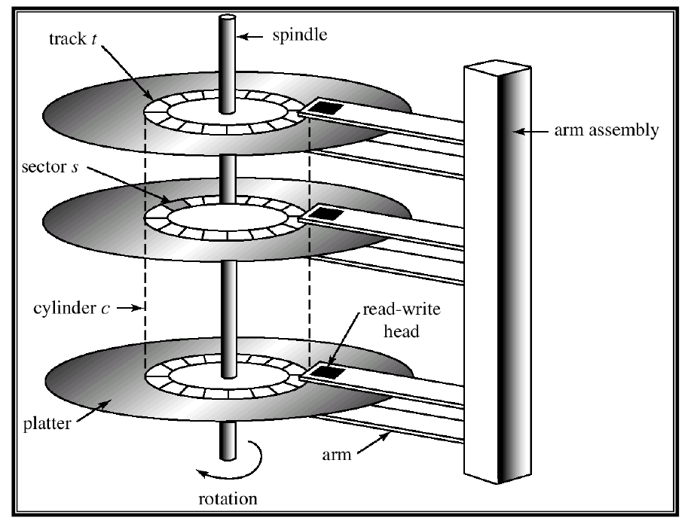
Example of a Disk

Slide 39

Single-track Latency: The Rotational Delay
Rotates this way
Rotational delay: Time for the desired sector to rotate
E.g., Full rotational delay is R and we start at sector 6
Read sector 0: Rotational delay = $\frac{R}{2}$
Read sector 5: Rotational delay = R-1 (worst case)
head
spindle
arm
A Single Track Plus A Head

Slide 40
Multiple Tracks: Seek Time
Rotates this way
Rotates this way
Remaining rotation
seek
spindle
spindle
Three Tracks Plus A Head (Right: With Seek)
(e.g., read to sector 11)
Seek: Move the disk arm to the correct track
Seek time: Time to move head to the track containing the desired sector.
One of the most costly disk operations.

Slide 41
Phases of Seek
Acceleration → Coasting → Deceleration → Settling
Acceleration: The disk arm gets moving.
Coasting: The arm is moving at full speed.
Deceleration: The arm slows down.
Settling: The head is carefully positioned over the correct track.
The settling time is often quite significant, e.g., 0.5 to 2ms.

Slide 42
Transfer
The final phase of I/O
Data is either read from or written to the surface.
Complete I/O time:
Seek
Waiting for the rotational delay
Transfer

Slide 43
Track Skew
Make sure that sequential reads can be properly serviced even when crossing track boundaries.
Without track skew, the head would be moved to the next track but the desired next block would have already rotated under the head.
Rotates this way
9
8
19
10
18
20
7
28
29
30
11
17
21
27
31
Spindle
6
16
26
32
22
0
25
33
5
15
24
34
23
35
1
14
12
4
13
2
3
Three Tracks: Track Skew Of 2

Slide 44
Cache (Track Buffer)
Hold data read from or written to the disk
Allow the drive to quickly respond to requests.
Small amount of memory (usually around 8 or 16 MB)

Slide 45
Write on cache
Write back (Immediate reporting)
Acknowledge a write has been completed when it has put the data in its memory.
faster but dangerous
Write through
Acknowledge a write has been completed after the write has actually been written to disk.

Slide 46

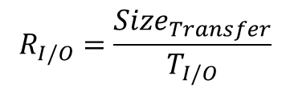
I/O Time: Doing The Math
I/O time ($T_{I/O}$):
The rate of I/O ($R_{I/O}$):
$$T_{I/O}=T_{seek}+T_{rotation}+T_{transfer}$$
$$R_{I/O}=\frac{{Size}_{Transfer}}{T_{I/O}}$$
 | Cheetah 15K.5 | Barracuda
Capacity | 300 GB | 1 TB
RPM | 15,000 | 7,200
Average Seek | 4 ms | 9 ms
Max Transfer | 125 MB/s | 105 MB/s
Platters | 4 | 4
Cache | 16 MB | 16/32 MB
Connects Via | SCSI | SATA
Disk Drive Specs: SCSI Versus SATA

Slide 47
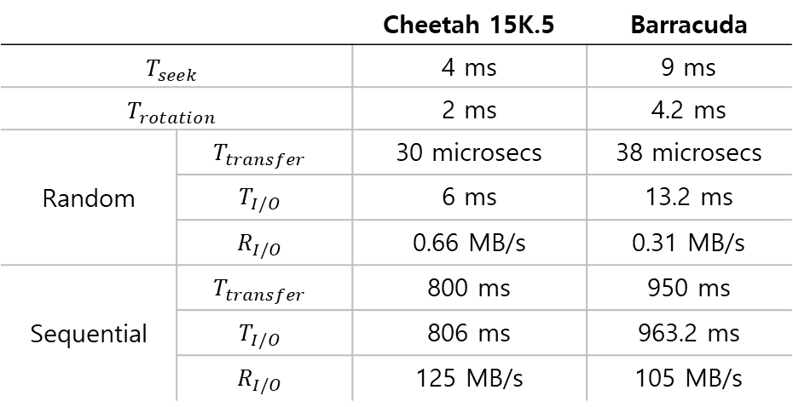
I/O Time Example
Random workload: Issue 4KB read to random locations on the disk
Sequential workload: Read 100MB consecutively from the disk
 |  | Cheetah 15K.5 | Barracuda
$$T_{seek}$$ |  | 4 ms | 9 ms
$$T_{rotation}$$ |  | 2 ms | 4.2 ms
Random | $$T_{transfer}$$ | 30 microsecs | 38 microsecs
 | $$T_{I/O}$$ | 6 ms | 13.2 ms
 | $$R_{I/O}$$ | 0.66 MB/s | 0.31 MB/s
Sequential | $$T_{transfer}$$ | 800 ms | 950 ms
 | $$T_{I/O}$$ | 806 ms | 963.2 ms
 | $$R_{I/O}$$ | 125 MB/s | 105 MB/s
Disk Drive Performance: SCSI Versus SATA
There is a huge gap in drive performance
between random and sequential workloads

Slide 48
Disk Scheduling
Disk Scheduler decides which I/O request to schedule next.
SSTF (Shortest Seek Time First)
Order the queue of I/O request by track
Pick requests on the nearest track to complete first
Rotates this way
9
8
21
10
20
22
7
32
33
34
11
19
23
SSTF: Scheduling Request 21 and 2
issue the request to 21 → issue the request to 2
31
35
Spindle
6
18
30
24
12
0
29
25
5
17
28
26
13
27
1
16
14
4
15
2
3

Slide 49
SSTF is not a panacea.
Problem 1: The drive geometry is not available to the host OS
Solution: OS can simply implement Nearest-block-first (NBF)
Problem 2: Starvation
If there were a steady stream of request to the inner track, request to other tracks would then be ignored completely.

Slide 50
Elevator (a.k.a. SCAN or C-SCAN)
Move across the disk servicing requests in order across the tracks.
Sweep: A single pass across the disk
If a request comes for a block on a track that has already been services on this sweep of the disk, it is queued until the next sweep.
F-SCAN
Freeze the queue to be serviced when it is doing a sweep
Avoid starvation of far-away requests
C-SCAN (Circular SCAN)
Sweep from outer-to-inner, and then inner-to-outer, etc.

Slide 51
How to account for Disk rotation costs?
Rotates this way
9
8
21
10
If rotation is faster than seek : request 16 → request 8
If seek is faster than rotation : request 8 → request 16
20
22
7
32
33
34
11
19
23
31
35
Spindle
6
18
30
24
12
0
29
25
5
17
28
26
13
27
1
16
14
4
15
2
3
SSTF: Sometimes Not Good Enough
On modern drives, both seek and rotation are roughly equivalent:
Thus, SPTF (Shortest Positioning Time First) is useful.

Slide 52
I/O merging
Reduce the number of request sent to the disk and lower overhead
E.g., read blocks 33, then 8, then 34:
The scheduler merge the request for blocks 33 and 34 into a single two-block request.

Slide 54
38. RAID
Operating System: Three Easy Pieces

Slide 55
RAID (Redundant Array of Inexpensive Disks)
Use multiple disks in concert to build a faster, bigger, and more reliable disk system.
RAID just looks like a big disk to the host system.
Advantage
Performance & Capacity: Using multiple disks in parallel
Reliability: RAID can tolerate the loss of a disk.
RAIDs provide these advantages transparently
to systems that use them.

Slide 56
RAID Interface
When a RAID receives I/O request,
The RAID calculates which disk to access.
The RAID issues one or more physical I/Os to do so.
RAID example: A mirrored RAID system
Keep two copies of each block (each one on a separate disk)
When writing, perform two physical I/Os for every one logical I/O it is issued.

Slide 57
RAID Internals
A microcontroller
Run firmware to direct the operation of the RAID
Volatile memory (such as DRAM)
Buffer data blocks
Non-volatile memory
Buffer writes safely
Specialized logic to perform parity calculation

Slide 58
Fault Model
RAIDs are designed to detect and recover from certain kinds of disk faults.
Fail-stop fault model
A disk can be in one of two states: Working or Failed.
Working: all blocks can be read or written.
Failed: the disk is permanently lost.
RAID controller can immediately observe when a disk has failed.

Slide 59
How to evaluate a RAID
Capacity
How much useful capacity is available to systems?
Reliability
How many disk faults can the given design tolerate?
Performance

Slide 60
RAID Level 0: Striping
RAID Level 0 is the simplest form as striping blocks.
Spread the blocks across the disks in a round-robin fashion.
No redundancy
Excellent performance and capacity
Disk 0 | Disk 1 | Disk 2 | Disk 3
0 | 1 | 2 | 3
4 | 5 | 6 | 7
8 | 9 | 10 | 11
12 | 13 | 14 | 15
Stripe
(The blocks in the same row)
RAID-0: Simple Striping
(Assume here a 4-disk array)

Slide 61
RAID Level 0 (Cont.)
Example: RAID-0 with a bigger chunk size
Chunk size : 2 blocks (8 KB)
A Stripe: 4 chunks (32 KB)
Disk 0 | Disk 1 | Disk 2 | Disk 3
0 | 2 | 4 | 6
1 | 3 | 5 | 7
8 | 10 | 12 | 14
9 | 11 | 13 | 15
chunk size:
2 blocks
Striping with a Bigger Chunk Size

Slide 62
Chunk Sizes
Chunk size mostly affects performance of the array
Small chunk size
Increasing the parallelism
Increasing positioning time to access blocks
Big chunk size
Reducing intra-file parallelism
Reducing positioning time
Determining the “best” chunk size is hard to do.
Most arrays use larger chunk sizes (e.g., 64 KB)

Slide 63

RAID Level 0 Analysis
Capacity → RAID-0 is perfect.
Striping delivers N disks worth of useful capacity.
Performance of striping → RAID-0 is excellent.
All disks are utilized often in parallel.
Reliability → RAID-0 is bad.
Any disk failure will lead to data loss.
$N$: the number of disks

Slide 64
Evaluating RAID Performance
Consider two performance metrics:
Single request latency
Steady-state throughput
Workload
Sequential: access MBs of data (e.g., block (B) to block (B + 10MB))
Random: access 4KB at random logical address
A disk can transfer data at
S MB/s under a sequential workload
R MB/s under a random workload

Slide 65
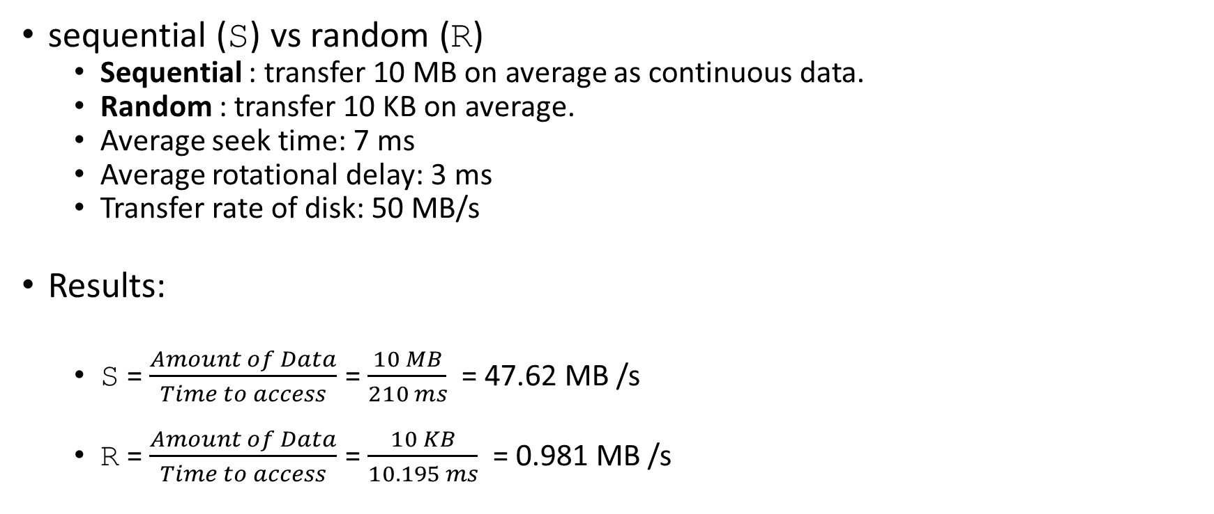
Evaluating RAID Performance Example
sequential (S) vs random (R)
Sequential : transfer 10 MB on average as continuous data.
Random : transfer 10 KB on average.
Average seek time: 7 ms
Average rotational delay: 3 ms
Transfer rate of disk: 50 MB/s
Results:
S = $\frac{Amount of Data}{Time to access}$ = $\frac{10 MB}{210 ms}$ = 47.62 MB /s
R = $\frac{Amount of Data}{Time to access}$ = $\frac{10 KB}{10.195 ms}$ = 0.981 MB /s

Slide 66


Evaluating RAID-0 Performance
Single request latency
Identical to that of a single disk.
Steady-state throughput
Sequential workload : $N∙S$ MB/s
Random workload : $N∙R$ MB/s
$N$: the number of disks

Slide 67
RAID Level 1 : Mirroring
RAID Level 1 tolerates disk failures.
Make more than one copy of each block in the system.
Each copy should be placed on a separate disk.
RAID-10 (RAID 1+0) : mirrored pairs and then stripe (the arrangement above)
RAID-01 (RAID 0+1) : contains two large striping (RAID-0) arrays, and then mirrors (RAID-1)
Disk 0 | Disk 1 | Disk 2 | Disk 3
0 | 0 | 1 | 1
2 | 2 | 3 | 3
4 | 4 | 5 | 5
6 | 6 | 7 | 7
Simple RAID-1: Mirroring (Keep two physical copies)

Slide 68

RAID-1 Analysis
Capacity: RAID-1 is Expensive
The useful capacity of RAID-1 is N/2.
Reliability: RAID-1 does well.
It can tolerate the failure of any one disk (up to N/2 failures depending on which disk fails).
$N$: the number of disks

Slide 69
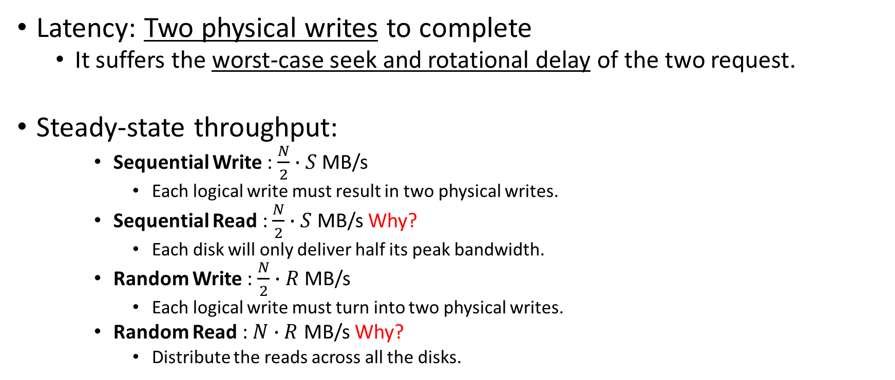
Performance of RAID-1
Latency: Two physical writes to complete
It suffers the worst-case seek and rotational delay of the two request.
Steady-state throughput:
Sequential Write : $\frac{N}{2}∙S$ MB/s
Each logical write must result in two physical writes.
Sequential Read : $\frac{N}{2}∙S$ MB/s Why?
Each disk will only deliver half its peak bandwidth.
Random Write : $\frac{N}{2}∙R$ MB/s
Each logical write must turn into two physical writes.
Random Read : $N∙R$ MB/s Why?
Distribute the reads across all the disks.

Slide 70
RAID Level 4 : Saving Space With Parity
Add a single parity block
A parity block stores the redundant information for that stripe of blocks.
* P: Parity
Disk 0 | Disk 1 | Disk 2 | Disk 3 | Disk 4
0 | 1 | 2 | 3 | P0
4 | 5 | 6 | 7 | P1
8 | 9 | 10 | 11 | P2
12 | 13 | 14 | 15 | P3
Five-disk RAID-4 system layout

Slide 71
RAID Level 4 (Cont.)
Compute parity : the XOR of all of bits
Recover from parity
Imagine the bit of the C2 in the first row is lost.
Reading the other values in that row : 0, 0, 1
The parity bit is 0 → even number of 1’s in the row
What the missing data must be: 1
C0 | C1 | C2 | C3 | P
0 | 0 | 1 | 1 | XOR(0,0,1,1)=0
0 | 1 | 0 | 0 | XOR(0,1,0,0)=1

Slide 72

RAID-4 Analysis
Capacity
The useful capacity is $\left(N−1\right)$.
Reliability
RAID-4 tolerates 1 disk failure and no more.
$N$: the number of disks

Slide 73

RAID-4 Analysis (Cont.)
Performance
Steady-state throughput
Sequential read: $\left(N−1\right)∙S$ MB/s
Sequential write: $\left(N−1\right)∙S$ MB/s
Random read: $\left(N−1\right)∙R$ MB/s
Disk 0 | Disk 1 | Disk 2 | Disk 3 | Disk 4
0 | 1 | 2 | 3 | P0
4 | 5 | 6 | 7 | P1
8 | 9 | 10 | 11 | P2
12 | 13 | 14 | 15 | P3
Full-stripe Writes In RAID-4

Slide 74
Random Write Performance for RAID-4
Overwrite a block + update the parity
Method 1: additive parity
Read in all of the other data blocks in the stripe
XOR those blocks with the new block (1)
Problem: the performance scales with the number of disks

Slide 75
Random Write Performance for RAID-4 (Cont.)
Method 2: subtractive parity
Update C2(old) → C2(new)
Read in the old data at C2 (C2(old)=1) and the old parity (P(old)=0)
Calculate P(new):
If C2(new)==C2(old) → P(new)==P(old)
If C2(new)!=C2(old) → Flip the old parity bit
C0 | C1 | C2 | C3 | P
0 | 0 | 1 | 1 | XOR(0,0,1,1)=0
$$P\left(new\right)=\left(C2\left(old\right) XOR C2\left(new\right)\right) XOR P(old)$$

Slide 76
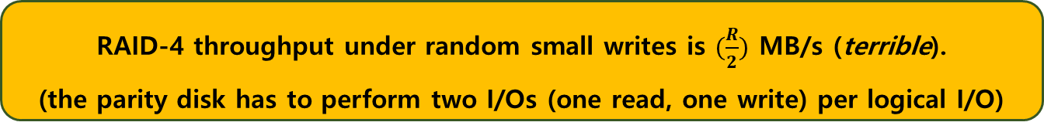
Small-write problem
The parity disk can be a bottleneck.
Example: update blocks 4 and 13 (marked with *)
Disk 0 and Disk 1 can be accessed in parallel.
Disk 4 prevents any parallelism.
Disk 0 | Disk 1 | Disk 2 | Disk 3 | Disk 4
0 | 1 | 2 | 3 | P0
*4 | 5 | 6 | 7 | +P1
8 | 9 | 10 | 11 | P2
12 | *13 | 14 | 15 | +P3
Writes To 4, 13 And Respective Parity Blocks.
RAID-4 throughput under random small writes is $(\frac{R}{2})$ MB/s (terrible).
(the parity disk has to perform two I/Os (one read, one write) per logical I/O)

Slide 77
I/O Latency in RAID-4
A single read
Equivalent to the latency of a single disk request.
A single write
Two reads and then two writes
Data block + Parity block
The reads can happen in parallel and writes can happen in parallel.
Total latency is about twice that of a single disk.

Slide 78
RAID Level 5: Rotating Parity
RAID-5 is a solution of small write problem.
Rotate the parity blocks across drives.
Remove the parity-disk bottleneck for RAID-4
Disk 0 | Disk 1 | Disk 2 | Disk 3 | Disk 4
0 | 1 | 2 | 3 | P0
5 | 6 | 7 | P1 | 4
10 | 11 | P2 | 8 | 9
15 | P3 | 12 | 13 | 14
P4 | 16 | 17 | 18 | 19
RAID-5 With Rotated Parity

Slide 79

RAID-5 Analysis
Capacity
The useful capacity for a RAID group is $\left(N−1\right)$.
Reliability
RAID-5 tolerates 1 disk failure and no more.
$N$: the number of disks

Slide 80

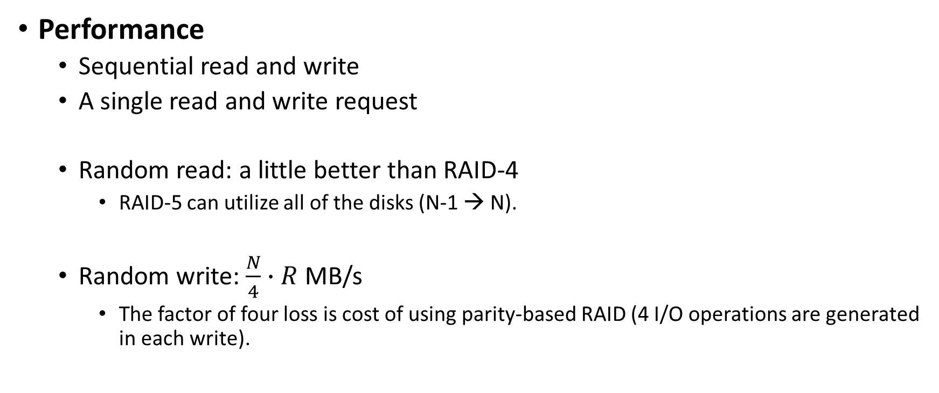
RAID-5 Analysis (Cont.)
Performance
Sequential read and write
A single read and write request
Random read: a little better than RAID-4
RAID-5 can utilize all of the disks (N-1 → N).
Random write: $\frac{N}{4}∙R$ MB/s
The factor of four loss is cost of using parity-based RAID (4 I/O operations are generated in each write).
Same as RAID-4
$N$: the number of disks

Slide 81
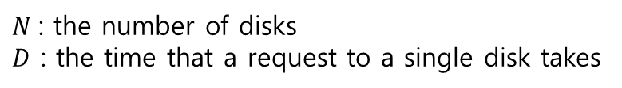
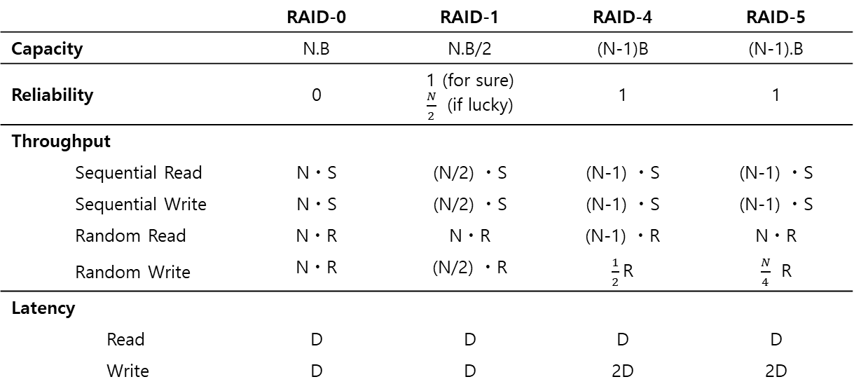
RAID Comparison: A Summary
$N$: the number of disks
$D$ : the time that a request to a single disk takes
 |  |  | RAID-0 | RAID-1 | RAID-4 | RAID-5
Capacity |  |  | N.B | N.B/2 | (N-1)B | (N-1).B
Reliability |  |  | 0 | 1 (for sure) $\frac{N}{2}$ (if lucky) | 1 | 1
Throughput
 | Sequential Read |  | NㆍS | (N/2) ㆍS | (N-1) ㆍS | (N-1) ㆍS
 | Sequential Write |  | NㆍS | (N/2) ㆍS | (N-1) ㆍS | (N-1) ㆍS
 | Random Read |  | NㆍR | NㆍR | (N-1) ㆍR | NㆍR
 | Random Write |  | NㆍR | (N/2) ㆍR | $\frac{1}{2}$R | $\frac{N}{4}$ R
Latency
 |  | Read | D | D | D | D
 |  | Write | D | D | 2D | 2D
RAID Capacity, Reliability, and Performance

Slide 82
RAID Comparison: A Summary
Performance and do not care about reliability → RAID-0 (Striping)
Random I/O performance and Reliability → RAID-1 (Mirroring)
Capacity and Reliability → RAID-5
Sequential I/O and Maximize Capacity → RAID-5

Slide 83
39. File and Directories
Operating System: Three Easy Pieces

Slide 84
Persistent Storage
Keep a data intact even if there is a power loss.
Hard disk drive
Solid-state storage device
Two key abstractions in the virtualization of storage
File
Directory

Slide 85
File
A linear array of bytes
Each file has low-level name as inode number
The user is not aware of this name.
File system has a responsibility to store data persistently on disk.

Slide 86
Directory
Directory is like a file, also has a low-level name.
It contains a list of (user-readable name, low-level name) pairs.
Each entry in a directory refers to either files or other directories.
Example:
A directory has an entry (“foo”, “10”)
A file “foo” with the low-level name “10”

Slide 87
Directory Tree (Directory Hierarchy)
/
root directory
Valid files (absolute pathname):
/foo/bar.txt
/bar/foo/bar.txt
Valid directory:
/
/foo
/bar
/bar/bar
/bar/foo/
foo
bar
bar.txt
bar
foo
Sub-directories
bar.txt
An Example Directory Tree

Slide 88
Creating Files
Use open() system call with O_CREAT flag.
O_CREAT : create file.
O_WRONLY : only write to that file while opened.
O_TRUNC : make the file size zero (remove any existing content).
open() system call returns a file descriptor.
File descriptor is an integer, and is used to access files.
int fd = open(“foo”, O_CREAT | O_WRONLY | O_TRUNC);

Slide 89

Question (to Ken Thompson – Unix co-father): What would you do differently if you were redesigning Unix? Answer: I’d spell creat with an e.

Slide 90
Reading and Writing Files
An Example of reading and writing ‘foo’ file
echo: redirect the output of echo to the file foo
cat: dump the contents of a file to the screen
prompt> echo hello > foo
prompt> cat foo
hello
prompt>
How does the cat program access the file foo ?
We can use strace to trace the system calls made by a program.

Slide 91
Reading and Writing Files (Cont.)
prompt> strace cat foo
…
open(“foo”, O_RDONLY|O_LARGEFILE) = 3
read(3, “hello\n”, 4096) = 6
write(1, “hello\n”, 6) = 6 // file descriptor 1: standard out
hello
read(3, “”, 4096) = 0 // 0: no bytes left in the file
close(3) = 0
…
prompt>
open(file descriptor, flags)
Return file descriptor (3 in example)
File descriptors 0, 1, 2 are for standard input/ output/ error.
read(file descriptor, buffer pointer, the size of the buffer)
Return the number of bytes it reads
write(file descriptor, buffer pointer, the size of the buffer)
Return the number of bytes it writes

Slide 92
Reading and Writing Files (Cont.)
Writing a file (A similar set of steps as in Read)
A file is opened for writing (open()).
The write()system call is called.
Repeatedly called for larger files
close()

Slide 93
Reading And Writing, But Not Sequentially
An open file has a current offset.
Determine where the next read or write will begin reading from or writing to within the file.
Update the current offset
Implicitly: A read or write of N bytes takes place, N is added to the current offset.
Explicitly: lseek()

Slide 94
Reading And Writing, But Not Sequentially (Cont.)
off_t lseek(int fildes, off_t offset, int whence);
fildes: File descriptor
offset: Position the file offset to a particular location within the file
whence: Determine how the seek is performed
From the man page:
If whence is SEEK_SET, the offset is set to offset bytes.
If whence is SEEK_CUR, the offset is set to its current location plus offset bytes.
If whence is SEEK_END, the offset is set to the size of the file plus offset bytes.

Slide 95
Writing Immediately with fsync()
The file system will buffer writes in memory for some time.
Example: for 5 seconds, or 30
Performance reasons
At that later point in time, the write(s) will actually be issued to the storage device.
Write seems to be completed quickly.
Data can be lost (e.g., the machine crashes).

Slide 96
Writing Immediately with fsync() (Cont.)
However, some applications require more than eventual guarantee.
Example: DBMS requires force writes to disk from time to time.
off_t fsync(int fd)
Filesystem forces all dirty (i.e., not yet written) data to disk for the file referred to by the file descriptor.
fsync() returns once all of these writes are completed.

Slide 97
Writing Immediately with fsync() (Cont.)
An Example for fsync():
In some cases, the directory that contains the file foo also needs fsync().
int fd = open("foo", O_CREAT | O_WRONLY | O_TRUNC);
assert (fd > -1)
int rc = write(fd, buffer, size);
assert (rc == size);
rc = fsync(fd);
assert (rc == 0);

Slide 98
Renaming Files
rename(char* old, char *new)
Rename a file to different name.
It is implemented as an atomic call.
Example: Change from foo to bar:
Example: How to update a file atomically using a file editor like emacs:
prompt> mv foo bar // mv uses the system call rename()
int fint fd = open("foo.txt.tmp", O_WRONLY|O_CREAT|O_TRUNC);
write(fd, buffer, size); // write out new version of file
fsync(fd);
close(fd);
rename("foo.txt.tmp", "foo.txt");

Slide 99
Getting Information About Files
stat(),fstat(): System calls showing the file metadata
Metadata is information about each file.
Example: Size, Low-level name, Permission, …
stat structure:
struct stat {
dev_t st_dev; /* ID of device containing file */
ino_t st_ino; /* inode number */
mode_t st_mode; /* protection */
nlink_t st_nlink; /* number of hard links */
uid_t st_uid; /* user ID of owner */
gid_t st_gid; /* group ID of owner */
dev_t st_rdev; /* device ID (if special file) */
off_t st_size; /* total size, in bytes */
blksize_t st_blksize; /* blocksize for filesystem I/O */
blkcnt_t st_blocks; /* number of blocks allocated */
time_t st_atime; /* time of last access */
time_t st_mtime; /* time of last modification */
time_t st_ctime; /* time of last status change */
};

Slide 100
Getting Information About Files (Cont.)
To see stat information, you can use the command line tool stat.
File system keeps this type of information in an inode structure.
prompt> echo hello > file
prompt> stat file
File: ‘file’
Size: 6 Blocks: 8 IO Block: 4096 regular file
Device: 811h/2065d Inode: 67158084 Links: 1
Access: (0640/-rw-r-----) Uid: (30686/ root) Gid: (30686/ remzi)
Access: 2011-05-03 15:50:20.157594748 -0500
Modify: 2011-05-03 15:50:20.157594748 -0500
Change: 2011-05-03 15:50:20.157594748 -0500

Slide 101
Removing Files
rm is Linux command to remove a file
rm call unlink() to remove a file.
prompt> strace rm foo
…
unlink(“foo”) = 0 // return 0 upon success
…
prompt>
Why it calls unlink() not “remove or delete” ?

Slide 102
Making Directories
mkdir(): Make a directory
When a directory is created, it is empty.
Empty directory has two entries: . (itself), .. (parent)
prompt> strace mkdir foo
…
mkdir(“foo”, 0777) = 0
prompt>
prompt> ls –a
./ ../
prompt> ls -al
total 8
drwxr-x--- 2 remzi remzi 6 Apr 30 16:17 ./
drwxr-x--- 26 remzi remzi 4096 Apr 30 16:17 ../

Slide 103
Reading Directories
A sample code to read directory entries (like ls).
The information available within struct dirent
int main(int argc, char *argv[]) {
DIR *dp = opendir("."); // open current directory
assert(dp != NULL);
struct dirent *d;
while ((d = readdir(dp)) != NULL) // read one directory entry
{
// print out the name and inode number of each file
printf("%d %s\n", (int) d->d_ino, d->d_name);
}
closedir(dp); // close current directory
return 0;
}
struct dirent {
char d_name[256]; /* filename */
ino_t d_ino; /* inode number */
off_t d_off; /* offset to the next dirent */
unsigned short d_reclen; /* length of this record */
unsigned char d_type; /* type of file */
}

Slide 104
Deleting Directories
rmdir(): Delete a directory.
Require that the directory be empty.
If you call rmdir()to a non-empty directory, it will fail.
i.e., only has “.” and “..” entries.

Slide 105
Hard Links
link(old pathname, new one)
Link a new file name to an old one
Create another way to refer to the same file
The command-line link program : ln
prompt> echo hello > file
prompt> cat file
hello
prompt> ln file file2 // create a hard link, link file to file2
prompt> cat file2
hello

Slide 106
Hard Links (Cont.)
The way link works:
Create another name in the directory.
Refer it to the same inode number of the original file.
The file is not copied in any way.
Then, we now just have two human names (file and file2) that both refers to the same file.

Slide 107
Hard Links (Cont.)
The result of link()
Two files have the same inode number, but two human names (file, file2).
There is no difference between file and file2.
Both just links to the same underlying metadata about the file.
prompt> ls -i file file2
67158084 file /* inode value is 67158084 */
67158084 file2 /* inode value is 67158084 */
prompt>

Slide 108
Hard Links (Cont.)
Thus, to remove a file, we call unlink().
reference count
Track how many different file names have been linked to this inode.
When unlink() is called, the reference count decrements.
If the reference count reaches zero, the filesystem frees the inode and related data blocks. → truly “delete” the file
truly ???
prompt> rm file
removed ‘file’
prompt> cat file2 // Still access the file
hello

Slide 109
Hard Links (Cont.)
The result of unlink()
stat() shows the reference count of a file.
prompt> echo hello > file /* create file*/
prompt> stat file
... Inode: 67158084 Links: 1 ... /* Link count is 1 */
prompt> ln file file2 /* hard link file2 */
prompt> stat file
... Inode: 67158084 Links: 2 ... /* Link count is 2 */
prompt> stat file2
... Inode: 67158084 Links: 2 ... /* Link count is 2 */
prompt> ln file2 file3 /* hard link file3 */
prompt> stat file
... Inode: 67158084 Links: 3 ... /* Link count is 3 */
prompt> rm file /* remove file */
prompt> stat file2
... Inode: 67158084 Links: 2 ... /* Link count is 2 */
prompt> rm file2 /* remove file2 */
prompt> stat file3
... Inode: 67158084 Links: 1 ... /* Link count is 1 */
prompt> rm file3

Slide 110
Symbolic Links (Soft Link)
Symbolic link is sometimes more useful than Hard link.
Hard Link cannot be created to a directory.
Hard Link cannot be created to a file in another disk partition.
Because inode numbers are only unique within a file system.
Create a symbolic link: ln -s
prompt> echo hello > file
prompt> ln –s file file2 /* option –s: create a symbolic link, */
prompt> cat file2
hello

Slide 111
Symbolic Links (Cont.)
What is different between Symbolic link and Hard Link?
Symbolic links are a third type the file system knows about.
The size of symbolic link (file2) is 4 bytes.
A symbolic link holds the pathname of the linked-to file as the data of the link file.
prompt> stat file
... regular file ...
prompt> stat file2
... symbolic link ... // Actually a file it self of a different type
prompt> ls -al
drwxr-x--- 2 remzi remzi 29 May 3 19:10 ./
drwxr-x--- 27 remzi remzi 4096 May 3 15:14 ../ // directory
-rw-r----- 1 remzi remzi 6 May 3 19:10 file // regular file
lrwxrwxrwx 1 remzi remzi 4 May 3 19:10 file2 -> file // symbolic link

Slide 112
Symbolic Links (Cont.)
If we link to a longer pathname, our link file would be bigger.
prompt> echo hello > alongerfilename
prompt> ln -s alongerfilename file3
prompt> ls -al alongerfilename file3
-rw-r----- 1 remzi remzi 6 May 3 19:17 alongerfilename
lrwxrwxrwx 1 remzi remzi 15 May 3 19:17 file3 -> alongerfilename

Slide 113
Symbolic Links (Cont.)
Dangling reference
When we remove the original file, symbolic link points nothing.
prompt> echo hello > file
prompt> ln -s file file2
prompt> cat file2
hello
prompt> rm file // remove the original file
prompt> cat file2
cat: file2: No such file or directory

Slide 114
Making and Mounting a File System
mkfs tool : Make a file system
Write an empty file system, starting with a root directory, on to a disk partition.
Input:
A device (such as a disk partition, e.g., /dev/sda1)
A file system type (e.g., ext3)

Slide 115
Making and Mounting a File System (Cont.)
mount()
Takes an existing directory as a target mount point.
Essentially paste a new file system onto the directory tree at that point.
Example:
The pathname /home/users/ now refers to the root of the newly-mounted directory.
prompt> mount –t ext3 /dev/sda1 /home/users
prompt> ls /home/users
a b

Slide 116
Making and Mounting a File System (Cont.)
mount program: show what is mounted on a system.
ext3: A standard disk-based file system
proc: A file system for accessing information about current processes
tmpfs: A file system just for temporary files
AFS: A distributed file system
/dev/sda1 on / type ext3 (rw)
proc on /proc type proc (rw)
sysfs on /sys type sysfs (rw)
/dev/sda5 on /tmp type ext3 (rw)
/dev/sda7 on /var/vice/cache type ext3 (rw)
tmpfs on /dev/shm type tmpfs (rw)
AFS on /afs type afs (rw)

Slide 118
Review Question
What is the absolute path name of the file with the relative path name of ../mehmet/x in the /usr/ahmet folder?
/usr/ahmet/mehmet/x
../mehmet/x
/usr/mehmet/x
/mehmet/x

Slide 119
40. File System Implementation
Operating System: Three Easy Pieces

Slide 120
What is ``secure erase’’?

Slide 121
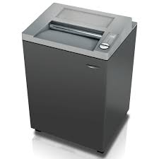

What is ``secure erase’’?

Slide 122
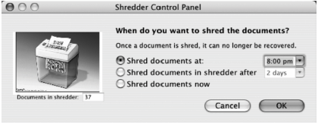
Mental Models
the use of a correct metaphor (shredder) for secure erase

Slide 123
The Way To Think
There are two different aspects to implement a file system
Data structures
What types of on-disk structures are utilized by the file system to organize its data and metadata?
Access methods
How does it map the calls made by a process like open(), read(), write(), etc.
Which structures are read during the execution of a particular system call?

Slide 124
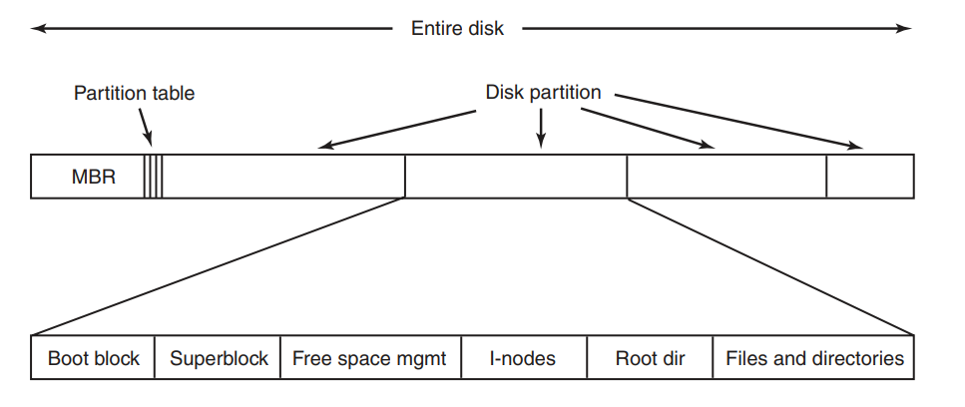
A Possible File System Layout

Slide 125
File System Layout
File systems are stored on disks.
Most disks can be divided up into one or more partitions, with independent file systems on each partition.
Sector 0 of the disk is called the MBR (Master Boot Record) and is used to boot the computer.
The end of the MBR contains the partition table. This table gives the starting and ending addresses of each partition.
One of the partitions in the table is marked as active.
When the computer is booted, the BIOS reads in and executes the MBR.
The first thing the MBR program does is locate the active partition, read in its first block, which is called the boot block, and execute it.
The program in the boot block loads the operating system contained in that partition.

Slide 126
File System Layout (Cont’d)
For uniformity, every partition starts with a boot block, even if it does not contain a bootable operating system. Besides, it might contain one in the future.
Other than starting with a boot block, the layout of a disk partition varies a lot from file system to file system.
Often the file system will contain some of the items shown.
The first one is the superblock. It contains all the key parameters about the file system and is read into memory when the computer is booted or the file system is first touched.
Typical information in the superblock includes a magic number to identify the file-system type, the number of blocks in the file system, and other key administrative information.

Slide 127
Overall Organization
Let’s develop the overall organization of the file system data structure.
First, divide the disk into blocks.
Block size is 4 KB.
The blocks are addressed from 0 to N -1.
0 7
8 15
16 23
24 31
32 39
40 47
48 55
56 63

Slide 128
Data region in file system
Reserve data region to store user data
File system has to track which data blocks comprise a file, the size of the file, its owner, etc.
Data Region
D | D | D | D | D | D | D | D
D | D | D | D | D | D | D | D
D | D | D | D | D | D | D | D
0 7
8 15
16 23
24 31
Data Region
D | D | D | D | D | D | D | D
D | D | D | D | D | D | D | D
D | D | D | D | D | D | D | D
D | D | D | D | D | D | D | D
32 39
40 47
48 55
56 63
How do we store these inodes in file system?

Slide 129
Inode table in file system
Reserve some space for inode table
This holds an array of on-disk inodes.
Example: for inode tables: use blocks# 3 ~ 7, inode size : 256 bytes
4-KB block can hold 16 inodes.
The filesystem contains 80 inodes (maximum number of files)
Inodes
Data Region
 | i | d | I | I | I | I | I
D | D | D | D | D | D | D | D
D | D | D | D | D | D | D | D
D | D | D | D | D | D | D | D
0 7
8 15
16 23
24 31
Data Region
D | D | D | D | D | D | D | D
D | D | D | D | D | D | D | D
D | D | D | D | D | D | D | D
D | D | D | D | D | D | D | D
32 39
40 47
48 55
56 63

Slide 130
Allocation Structures
This is to track whether inodes or data blocks are free or allocated.
Use bitmap, each bit indicates free(0) or in-use(1)
data bitmap: for data region
inode bitmap: for inode table
Inodes
Data Region
 | i | d | I | I | I | I | I
D | D | D | D | D | D | D | D
D | D | D | D | D | D | D | D
D | D | D | D | D | D | D | D
0 7
8 15
16 23
24 31
Data Region
D | D | D | D | D | D | D | D
D | D | D | D | D | D | D | D
D | D | D | D | D | D | D | D
D | D | D | D | D | D | D | D
32 39
40 47
48 55
56 63

Slide 131
Superblock
Super block contains the information for a particular file system
Example: The number of inodes, begin location of inode table. etc
Thus, when mounting a file system, OS will read the superblock first, to initialize various information.
Inodes
Data Region
S | i | d | I | I | I | I | I
D | D | D | D | D | D | D | D
D | D | D | D | D | D | D | D
D | D | D | D | D | D | D | D
0 7
8 15
16 23
24 31
Data Region
D | D | D | D | D | D | D | D
D | D | D | D | D | D | D | D
D | D | D | D | D | D | D | D
D | D | D | D | D | D | D | D
32 39
40 47
48 55
56 63

Slide 132
File Organization: The inode
Each inode is referred to by its inode number.
By inode number, file system calculates where the inode is on the disk.
Example: inode number: 32
Calculate the offset into the inode region (32 x sizeof(inode) (256 bytes) = 8192
Add start address of the inode table(12 KB) + inode region(8 KB) = 20 KB
The Inode table
iblock 0
iblock 1
iblock 2
iblock 3
iblock 4
Super | i-bmap | d-bmap | 0 | 1 | 2 | 3 | 16 | 17 | 18 | 19 | 32 | 33 | 34 | 35 | 48 | 49 | 50 | 51 | 64 | 65 | 66 | 67
 |  |  | 4 | 5 | 6 | 7 | 20 | 21 | 22 | 23 | 36 | 37 | 38 | 39 | 52 | 53 | 54 | 55 | 68 | 69 | 70 | 71
 |  |  | 8 | 9 | 10 | 11 | 24 | 25 | 26 | 27 | 40 | 41 | 42 | 43 | 56 | 57 | 58 | 59 | 72 | 73 | 74 | 75
 |  |  | 12 | 13 | 14 | 15 | 28 | 29 | 30 | 31 | 44 | 45 | 46 | 47 | 60 | 61 | 62 | 63 | 76 | 77 | 78 | 79
0KB
4KB
8KB
12KB
16KB
20KB
24KB
28KB
32KB

Slide 133
File Organization: The inode (Cont.)
Disk are not byte addressable, sector addressable.
Disk consists of a large number of addressable sectors, (512 bytes)
Example: Fetch the block of inode (inode number: 32)
Sector address iaddr of the inode block:
blk: (inumber * sizeof(inode)) / blocksize
sector: (blk * blocksize) + inodeStartAddr ) /sectorsize
The Inode table
iblock 0
iblock 1
iblock 2
iblock 3
iblock 4
Super | i-bmap | d-bmap | 0 | 1 | 2 | 3 | 16 | 17 | 18 | 19 | 32 | 33 | 34 | 35 | 48 | 49 | 50 | 51 | 64 | 65 | 66 | 67
 |  |  | 4 | 5 | 6 | 7 | 20 | 21 | 22 | 23 | 36 | 37 | 38 | 39 | 52 | 53 | 54 | 55 | 68 | 69 | 70 | 71
 |  |  | 8 | 9 | 10 | 11 | 24 | 25 | 26 | 27 | 40 | 41 | 42 | 43 | 56 | 57 | 58 | 59 | 72 | 73 | 74 | 75
 |  |  | 12 | 13 | 14 | 15 | 28 | 29 | 30 | 31 | 44 | 45 | 46 | 47 | 60 | 61 | 62 | 63 | 76 | 77 | 78 | 79
0KB
4KB
8KB
12KB
16KB
20KB
24KB
28KB
32KB

Slide 134
File Organization: The inode (Cont.)
inode has all of the information about a file
File type (regular file, directory, etc.),
Size, the number of blocks allocated to it.
Protection information (who ownes the file, who can access, etc).
Time information
Etc.

Slide 135
File Organization: The inode (Cont.)
Size Name What is this inode field for?
2 mode can this file be read/written/executed?
2 uid who owns this file?
4 size how many bytes are in this file?
4 time what time was this file last accessed?
4 ctime what time was this file created?
4 mtime what time was this file last modified?
4 dtime what time was this inode deleted?
4 gid which group does this file belong to?
2 links_count how many hard links are there to this file?
2 blocks how many blocks have been allocated to this file?
4 flags how should ext2 use this inode?
4 osd1 an OS-dependent field
60 block a set of disk pointers (15 total)
4 generation file version (used by NFS)
4 file_acl a new permissions model beyond mode bits
4 dir_acl called access control lists
4 faddr an unsupported field
12 i_osd2 another OS-dependent field
The EXT2 Inode

Slide 136
The Multi-Level Index
To support bigger files, we use multi-level index.
Indirect pointer points to a block that contains more pointers.
inode has fixed number of direct pointers (12) and a single indirect pointer.
If a file grows large enough, an indirect block is allocated, inode’s slot for an indirect pointer is set to point to it.
(12 + 1024) x 4 K or 4144 KB

Slide 137
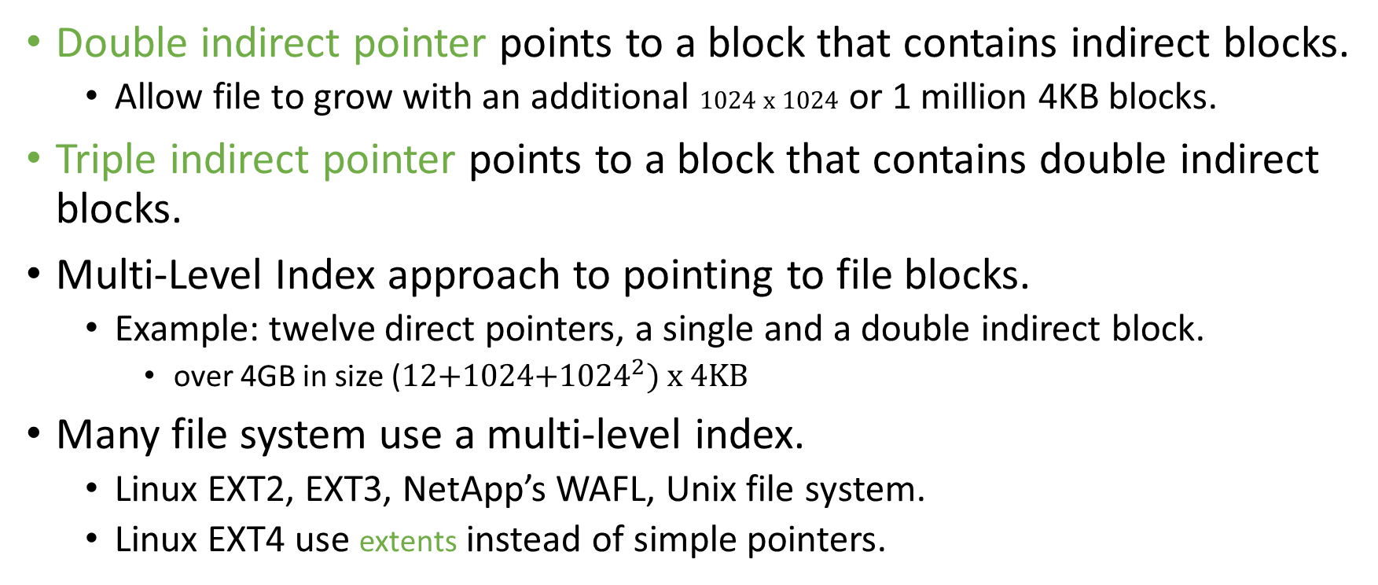
The Multi-Level Index (Cont.)
Double indirect pointer points to a block that contains indirect blocks.
Allow file to grow with an additional 1024 x 1024 or 1 million 4KB blocks.
Triple indirect pointer points to a block that contains double indirect blocks.
Multi-Level Index approach to pointing to file blocks.
Example: twelve direct pointers, a single and a double indirect block.
over 4GB in size (12+1024+${1024}^{2}) x 4KB$
Many file system use a multi-level index.
Linux EXT2, EXT3, NetApp’s WAFL, Unix file system.
Linux EXT4 use extents instead of simple pointers.

Slide 138
File Statistics
Most files are small Roughly 2K is the most common size
Average file size is growing Almost 200K is the average
Most bytes are stored in large files A few big files use most of the space
File systems contains lots of files Almost 100K on average
File systems are roughly half full Even as disks grow, file system remain -50% full
Directories are typically small Many have few entries; most have 20 or fewer
File System Measurement Summary

Slide 139
Directory Organization
Directory contains a list of (entry name, inode number) pairs.
Each directory has two extra files .”dot” for current directory and ..”dot-dot” for parent directory
For example, dir has three files (foo, bar, foobar):
inum | reclen | strlen | name
5 4 2 .
2 4 3 ..
12 4 4 foo
13 4 4 bar
24 8 7 foobar

Slide 140
Free Space Management
File system tracks which inodes and data blocks are free or not.
In order to manage free space, we have two simple bitmaps.
When file is newly created, it is allocated inode by searching the inode bitmap and update on-disk bitmap.
Pre-allocation policy is commonly used for allocation of contiguous blocks.

Slide 141
Access Paths: Reading a File From Disk
Issue an open(“/foo/bar”, O_RDONLY),
Traverse the pathname and thus locate the desired inode.
Begin at the root of the file system (/)
In most Unix file systems, the root inode number is 2
Filesystem reads in the block that contains inode number 2.
Look inside of it to find pointer to data blocks (contents of the root).
By reading in one or more directory data blocks, It will find “foo” directory.
Traverse recursively the path name until the desired inode (“bar”)
Check finale permissions, allocate a file descriptor for this process and returns file descriptor to user.

Slide 142
Access Paths: Reading a File From Disk (Cont.)
Issue read() to read from the file.
Read in the first block of the file, consulting the inode to find the location of such a block.
Update the inode with a new last accessed time.
Update in-memory open file table for file descriptor, the file offset.
When file is closed:
File descriptor should be deallocated, but for now, that is all the file system really needs to do. No disk I/Os take place.

Slide 143
Access Paths: Reading a File From Disk (Cont.)
 | data bitmap | inode bitmap | root inode | foo inode | bar inode | root data | foo data | bar data[0] | bar data[1] | bar data[2]
open(bar) |  |  | read | read | read | read | read
read() |  |  |  |  | read write |  |  | read
read() |  |  |  |  | read write |  |  |  | read
read() |  |  |  |  | read write |  |  |  |  | read
File Read Timeline (Time Increasing Downward)

Slide 144
Access Paths: Writing to Disk
Issue write() to update the file with new contents.
File may allocate a block (unless the block is being overwritten).
Need to update data block, data bitmap.
It generates five I/Os:
one to read the data bitmap
one to write the bitmap (to reflect its new state to disk)
two more to read and then write the inode
one to write the actual block itself.
To create file, it also allocates space within the directory containing the file, causing high I/O traffic.

Slide 145
Access Paths: Writing to Disk (Cont.)
 | data bitmap | inode bitmap | root inode | foo inode | bar inode | root data | foo data | bar data[0] | bar data[1] | bar data[2]
create (/foo/bar) |  | read write | read | read write | read write | read | read write
write() | read write |  |  |  | read write |  |  | write
write() | read write |  |  |  | read write |  |  |  | write
write() | read write |  |  |  | read write |  |  |  |  | write
File Creation Timeline (Time Increasing Downward)

Slide 146
Caching and Buffering
Reading and writing files are expensive, incurring many I/Os.
For example, long pathname(/1/2/3/…./100/file.txt)
One to read the inode of the directory and at least one to read its data.
Literally performs hundreds of reads just to open the file.
In order to reduce I/O traffic, file systems aggressively use system memory (DRAM) to cache.
Early file systems use fixed-size cache to hold popular blocks.
Static partitioning of memory can be wasteful;
Modem systems use dynamic partitioning approach, unified page cache.
Read I/O can be avoided by large cache.

Slide 147
Caching and Buffering (Cont.)
Write traffic has to go to disk for persistence. Thus, cache does not reduce write I/Os.
File system uses write buffering for write performance benefits.
delaying the writes (file system batches some updates into a smaller set of I/Os).
By buffering a number of writes in memory, the file system can then schedule the subsequent I/Os more efficiently.
By avoiding writes
Some applications force flush data to disk by calling fsync()or makes direct I/O.

Slide 148
How about Windows?

Slide 150
Last Words (Where could we go from here?)
«With every release, software gets more complex and less secure until the only security left is job security.»
- Al Eldridge
Further courses taught by me: BGK503, BGK504, others.
Apply for Internship/Part-time positions at Securify (the company I’ve co-founded).

